Slide 1
Ground rules
Sustainable
Our PPTs default mode is dark. Energy saved in every slide. Navigate through the bright cover slides and use the Knowit-black-background for everything else.
Accessible
Our columns are narrow and line lengths short for an easy, and accessible read
Keep it simple
Highlight only what strengthens your story. Leave everything else behind. And make every illustration count ☺

Slide 2
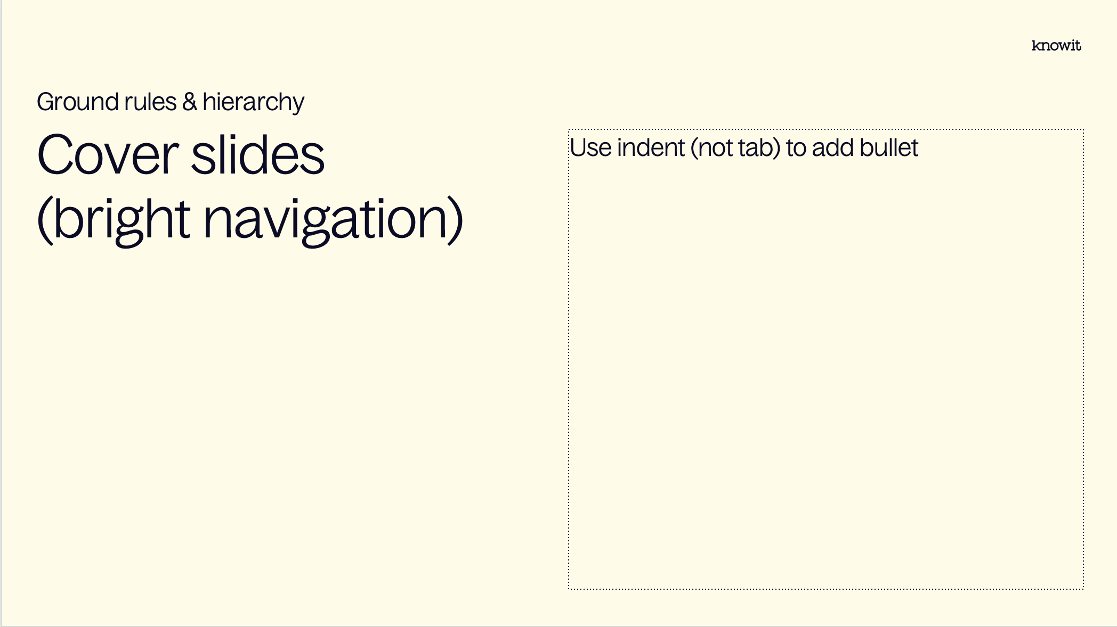
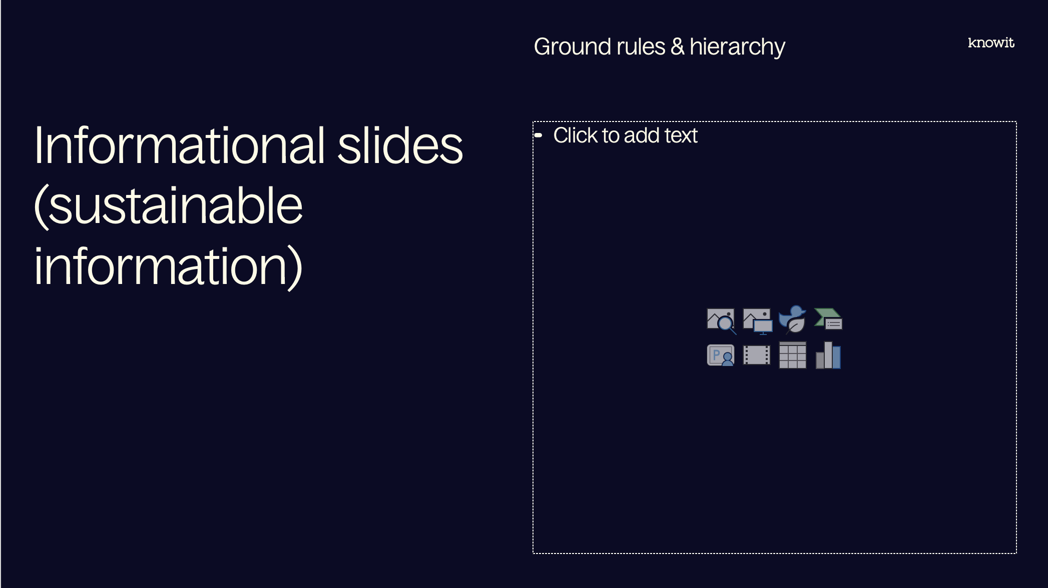
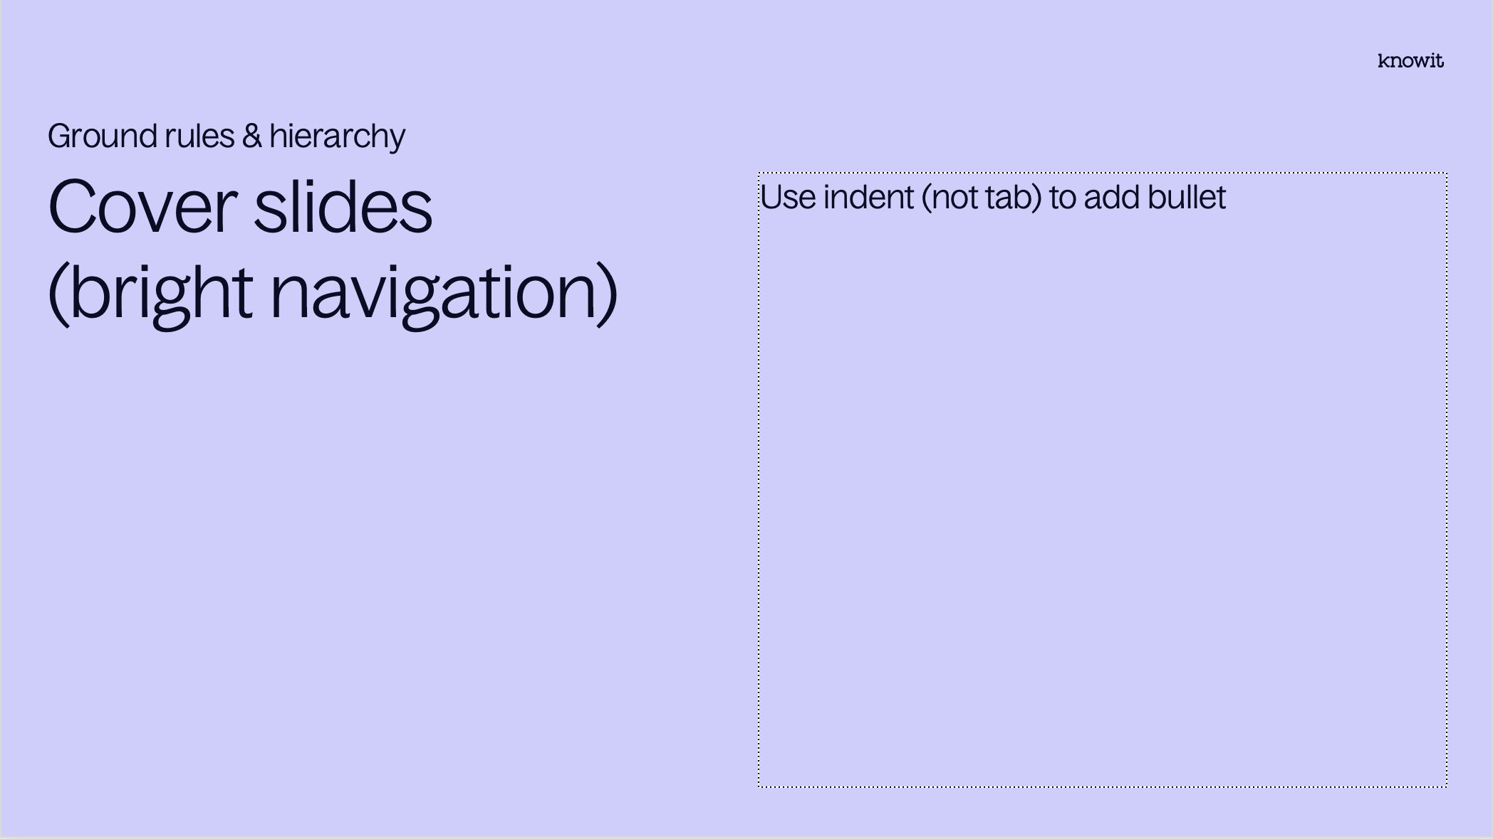
Visual prioritization

Slide 3
PowerPoint skills
Tips
Our template contains 38 different layouts, choose with care (and ask a colleague if you can’t find them)
The layout names might be helpful
Confused about colors or typographic rules? Check out the margins for some guidance
Have fun! (Break some rules if it helps you elevate your kick-ass-content☺)

Slide 5
Embedded academy Electronics and HW interfaces

Slide 6
Content
Introduction
ARM assembler
Processor manual, deep dive
DAC and ADCs
Timers and Interrupts
Voltage dividers
Level switches
Measurement

Slide 7
Lab
Introduction
Implement low lever drivers

Slide 8
Notes from previous session

Slide 9
Reminder for today
Notes from last session
Processor components

Slide 10
Processor manual

Slide 11
Parts of documentation
Processor manual
Reference manual
Application notes
Code examples

Slide 12
DAC and ADCs

Slide 13
Timers and interrupts

Slide 14
Voltage dividers

Slide 15
Level switches

Slide 16
Measurement

Slide 17
Questions?

Slide 18
Lab part

Slide 19












































































Our icons

Slide 20

















UN SDG (PNG)

Slide 21

















UN SDG (SVG)

